Slide 1
Lazy Loading
the Design Pattern
Definition
"Lazy loading is a design pattern commonly used in computer programming to defer initialization of an object until the point at which it is needed. It can contribute to efficiency in the program's operation if properly and appropriately used. The opposite of lazy loading is eager loading."

Slide 2
What does that mean?
You want to be as lazy as possible, and hope that someone else comes along and does all the work for you.
Wait what?
Lazy loading really means waiting to get data or process an object until you need it; not before. If you get data before and it's never used, the time it took was wasted. Also, getting all your data up front can make the user think the application is slow or unresponsive at first. Deferring certain data/processing to lazy load lets your application focus on more immediate/important code.

Slide 3
Implementations
There are four common implementations:
Lazy initialization
Virtual proxy
Ghost
Value holder

Slide 4
Lazy initialization
With lazy initialization, the object to be lazily loaded is originally set to null, and every request for the object checks for null and creates it "on the fly" before returning it first, as in this C# example:
private int myWidgetID;
private Widget myWidget = null;
public Widget MyWidget {
Get
{ if (myWidget == null)
{ myWidget = Widget.Load(myWidgetID);
} return myWidget;
} }

Slide 5
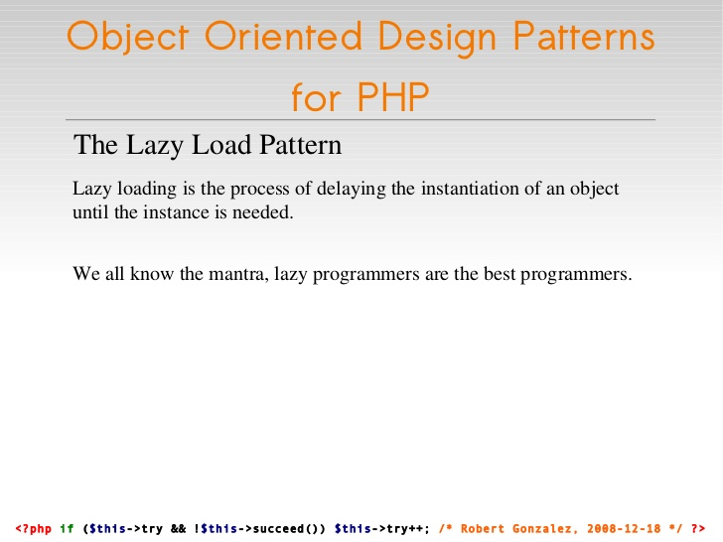

Slide 6
